Slide 1
University Management System - Database Design
By Pretty Karibo

Slide 2
INTRODUCTION
Purpose: Establish a robust database system to manage and analyze university data.
Key Components:
Tables: Students, Professors, Departments, Courses, Enrollments.
Relations: Ensuring data integrity with foreign keys.
Advanced Features: Views, Functions, Procedures for simplified queries.
Objective: Ensure seamless management of university data, ease of analytics, and swift reporting.

Slide 3
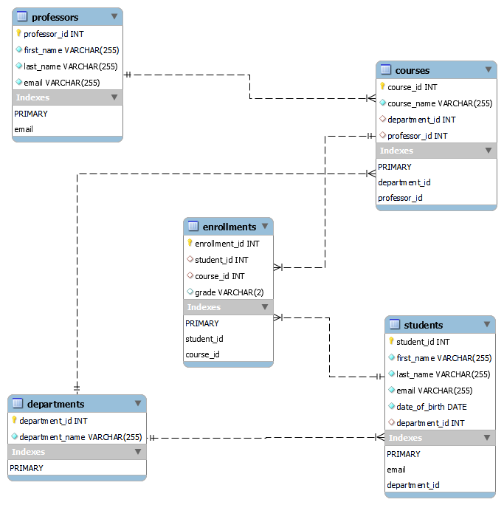
Entity Relationship Diagram

Slide 4
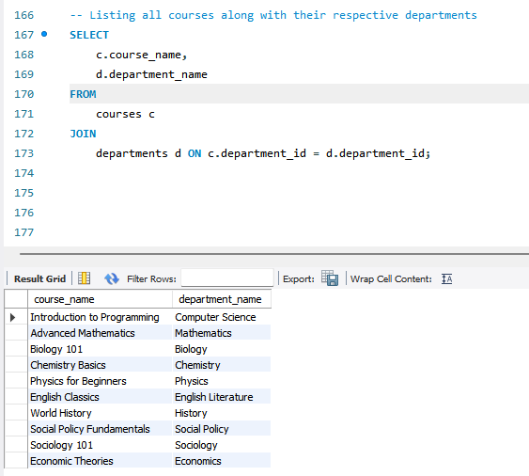
Query listing all courses along with their respective departments

Slide 5
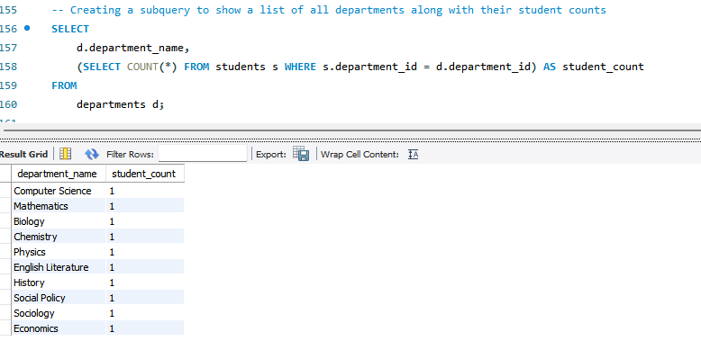
A query to count students in each department

Slide 6
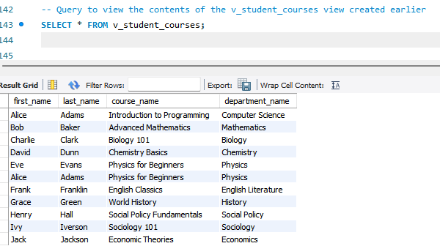
Combining multiple tables in a logical way

Slide 7
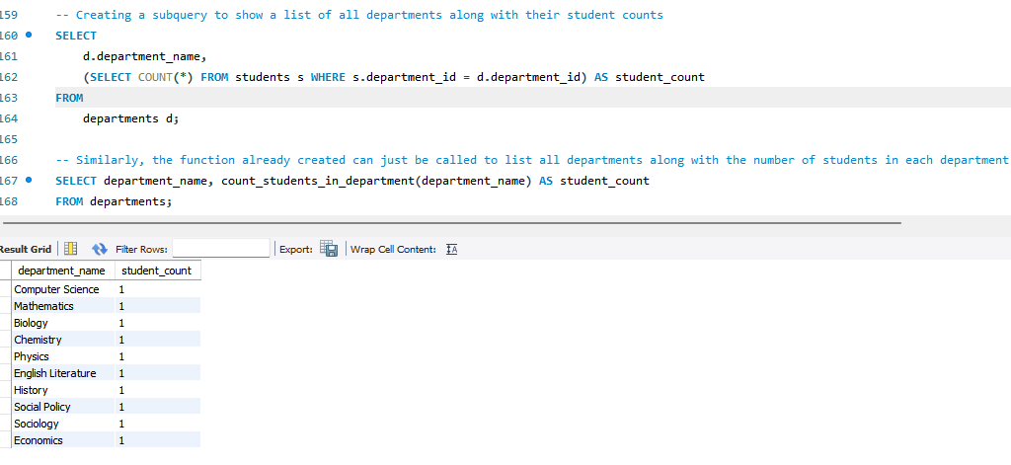
Subquery and Stored Procedure

Slide 8
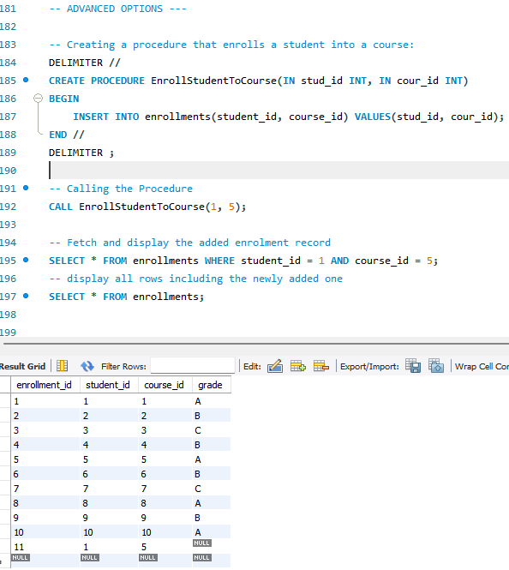
ADVANCED OPTIONS - A procedure that enrols a student into a course

Slide 9
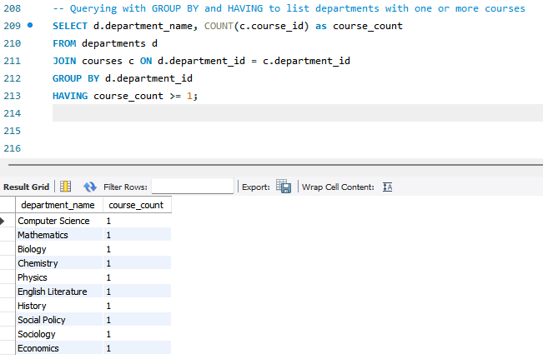
A QUERY WITH GROUP BY AND HAVING

Slide 10
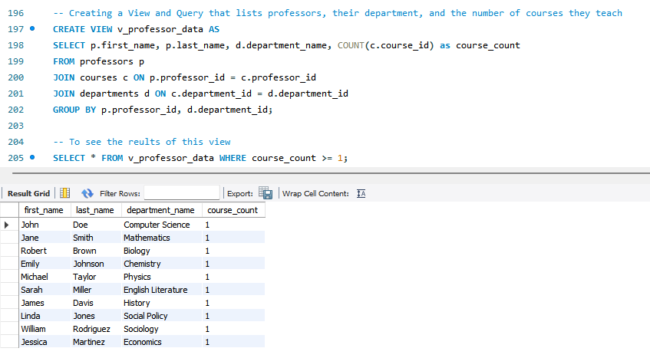
A VIEW LISTING PROFESSORS DETAILS

Slide 11
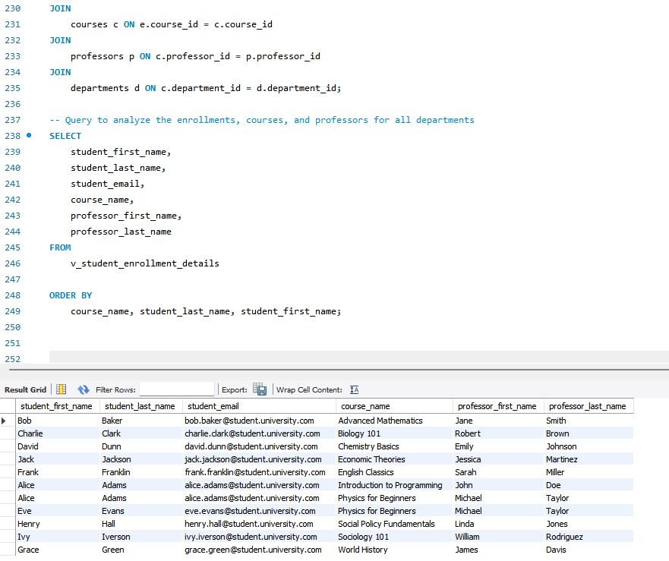
A View Utilizing Multiple Tables: Student Enrolment Details

Slide 12
Conclusion
Achievements: Successfully set up a comprehensive database with relational integrity, ensuring data consistency.
Analytics Ready: With views and functions, the system is geared for quick and in-depth analyses.
Scalability: Designed to accommodate growth, be it more students, courses, or advanced analytics requirements.
Next Steps: Explore advanced analytics, integration with other university systems, and user feedback for continuous improvement.

